Slide 1
Shifting Water Use in North Carolina
Presentation to the NC Environmental Management Commission Water Allocation Committee
July 10, 2019
Raleigh, NC
Austin Thompson
Project Director

Slide 2
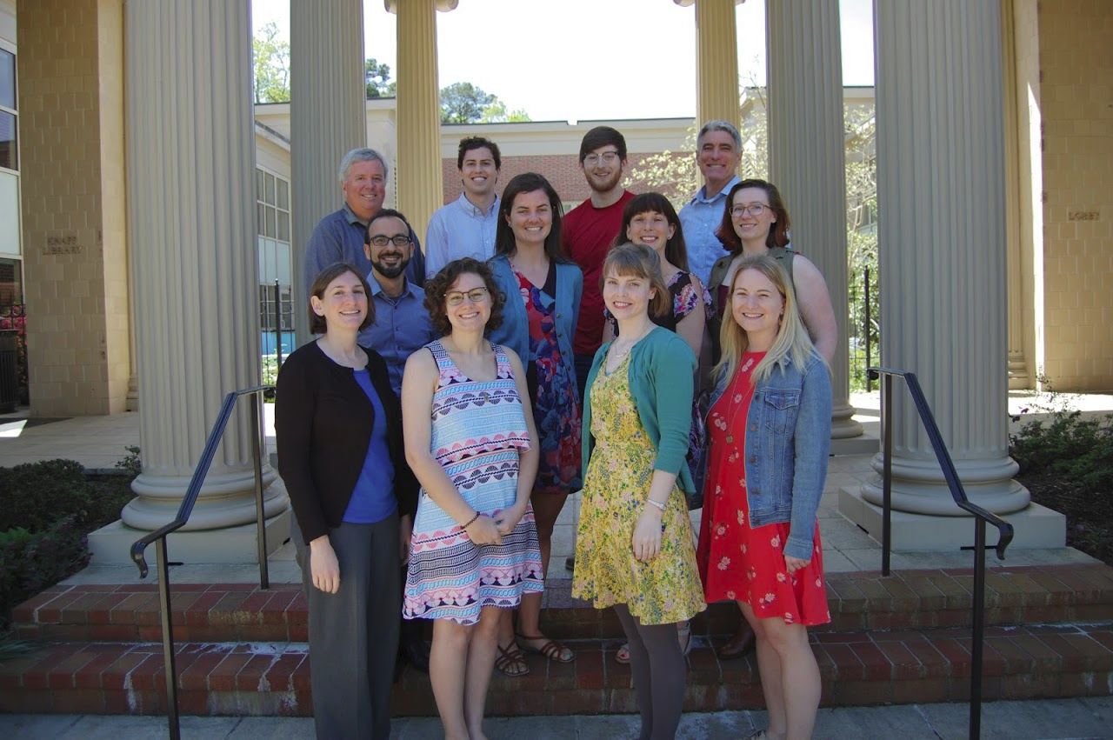
Dedicated to enhancing the ability of governments and other organizations to provide environmental programs and services in fair, effective, and financially sustainable ways through:
Applied Research
Teaching and Outreach
Program Design and Evaluation
How you pay for it matters.

Slide 3
Background
Notes:
Just talk here about

Slide 4
Types of Available Data
Data Source | Data Reporting | Data Type | Units Used
Local Water Supply Plan | Self reported by utilities | Metered water usage for several categories (residential, institutional, industrial, commercial) | Metered Usage (MGD), Metered Connections
USGS | State, federal sources | Withdrawals used for Municipal Public Supply | Usage by county
Annual Finance Information Report (AFIR) | Self reported by utilities | Water supplied to system and water billed to customers | Amount per year per utility
Customer level usage | Utilities | Monthly sales by customer class | Gallons per month per account

Slide 5
Measuring “Water Demand”
Gallons per connection per month
MGD Total
Withdrawals vs. treated into system vs. metered
Gallons per capita per day

Slide 6
Types of Analysis
LWSP Analysis
LGC Sales Data
Utility Level Analysis
Just for this meeting
Examples of analysis common at the EFC

Slide 7
Takeaways Spoiler!
Water usage patterns differ in different regions
Overall water usage is falling across the state
Water usage per connection is falling across the state

Slide 8
The Data

Slide 9
The Data
LWSP Data
2002, 2007, 2012, 2016, 2017
119 utilities
Metered usage (MGD)
Residential
Non-Residential
Metered connections
Residential
Non-Residential
Notes:
Non-residential includes: institutional, industrial, and commercial

Slide 10
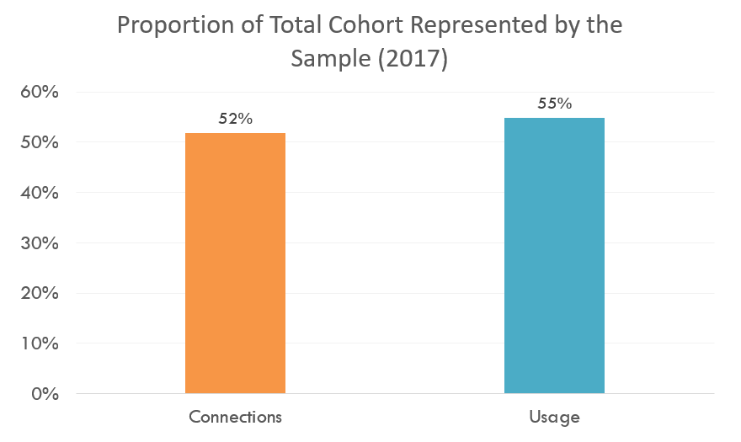
How does the Sample Compare? Using 2017 Data as an Example
Notes:
119 utilities—about 20-25%

Slide 11
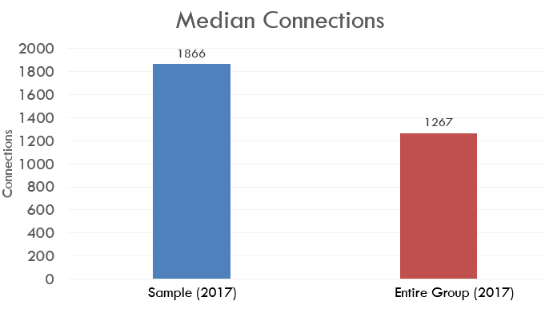
How does the Sample Compare? Using 2017 Data as an Example

Slide 12
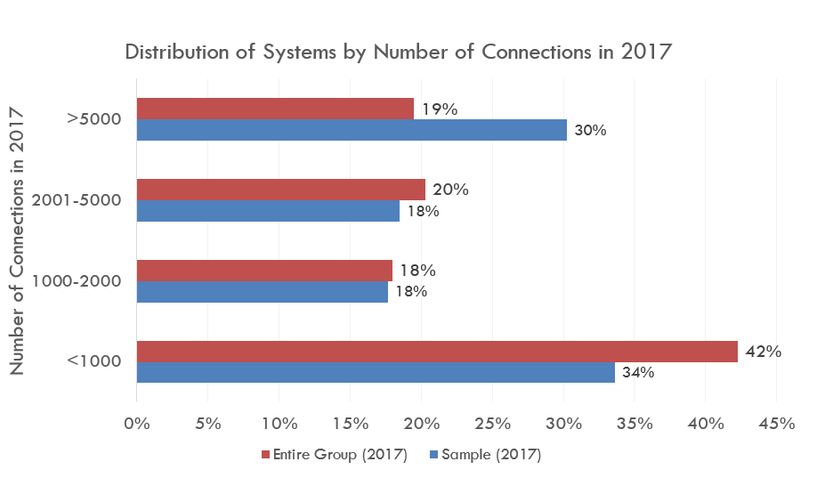
How does the Sample Compare? Using 2017 Data as an Example

Slide 13
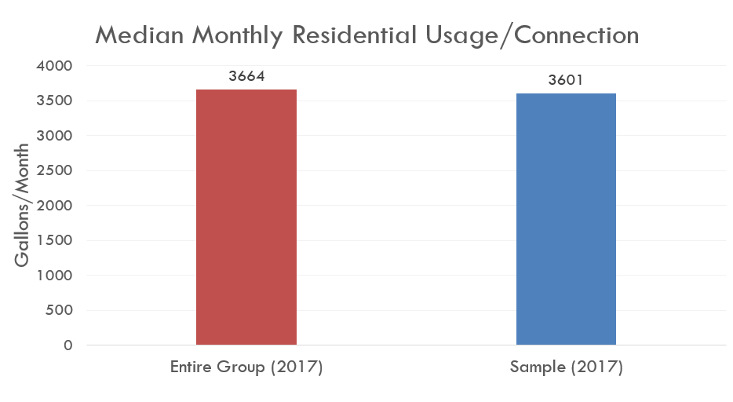
How does the Sample Compare? Using 2017 Data as an Example

Slide 14
The Results

Slide 15
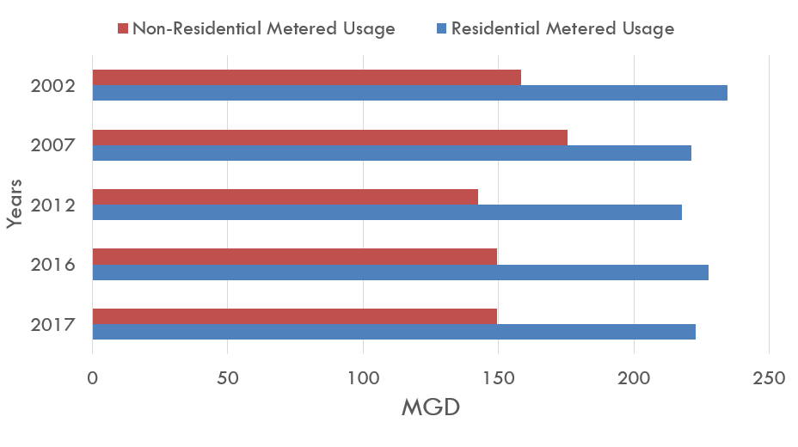
Total Metered Water Use by Category For the Sample of 119 Utilities Present in 2002, 2007, 2012, 2016, & 2017
Notes:
Talk about general trend in decline for both usages, but non-residential metered

Slide 16
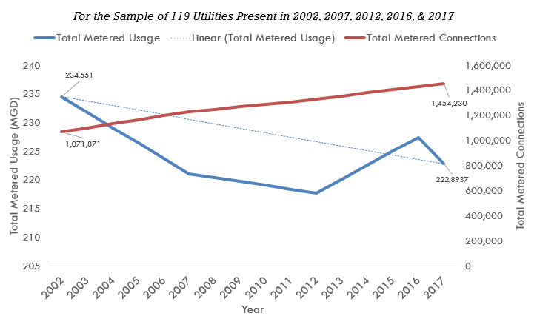
Total Residential Usage vs. Total Residential Metered Connections For the Sample of 119 Utilities Present in 2002, 2007, 2012, 2016, & 2017
Notes:
Clarify that this is sample.

Slide 17
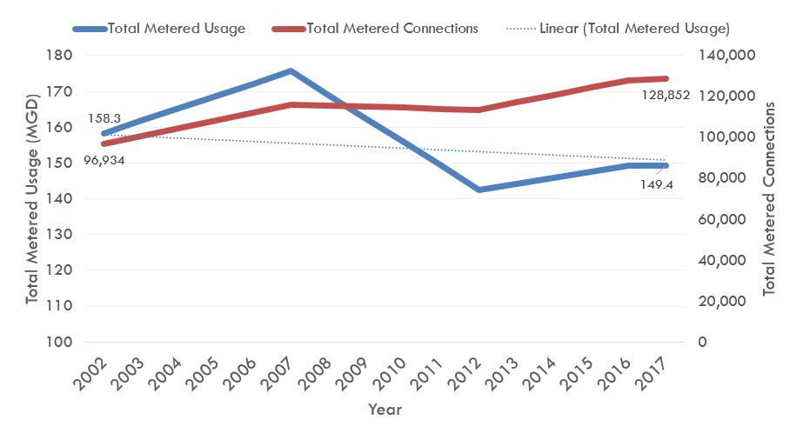
Total Non-Residential Usage vs. Total Non-Residential Metered Connections For the Sample of 119 Utilities Present in 2002, 2007, 2012, 2016, & 2017
Notes:
Clarify that this is sample.

Slide 18
Table of Residential Metered Water Use per Connection For the Sample of 119 Utilities Present in 2002, 2007, 2012, 2016, & 2017
Year | Median usage per connection
2002 | 169.7
2007 | 151.5
2012 | 128.5
2016 | 125.8
2017 | 120.5
*In Gallons/Day

Slide 19
Table of Residential Metered Water Use per Connection For the Sample of 45 “Small” Utilities and 22 “Large” Utilities
Year | Usage per connection per day For utilities serving 10000 or more connections (N=45) | Usage per Connection per day For utilities serving fewer than 1000 connections (N= 22)
2002 | 197.1 | 137.8
2006 | 169.8 | 129.8
2012 | 147.7 | 113.1
2016 | 149.1 | 111.1
2017 | 142.9 | 115.5
*In Gallons/Day

Slide 20
Have Connections Trended Differently Across the State? For the Sample of Utilities Present in 2002, 2007, 2012, 2016, & 2017

Slide 21
Has Residential Use Shifted Differently Across the State? For the Sample of Utilities Present in 2002, 2007, 2012, 2016, & 2017
Notes:
Total metered usage

Slide 22
Utility Level Analysis Example
Notes:
Done this for large urban utilities, through the state of California, and within the state—examples that follow show the within state analysis

Slide 23
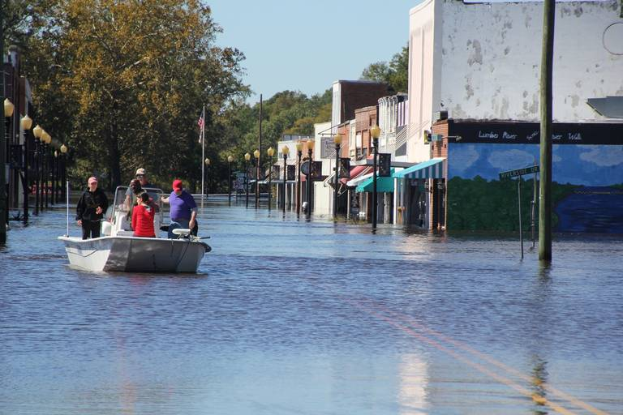
Fair Bluff, NC
One of five towns in SE NC that was part of a thorough viability analysis by Division of Water Infrastructure
Suffered flooding after Matthew, then again with Florence
Right along the Lumber River
September 16, 2018
Photo: post-Hurricane Matthew, 2016, The Sun News

Slide 24
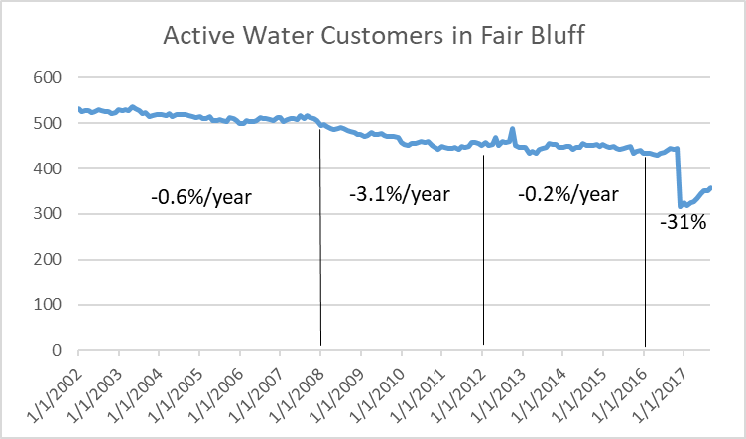
Actual Number of Fair Bluff Customers - Water

Slide 25
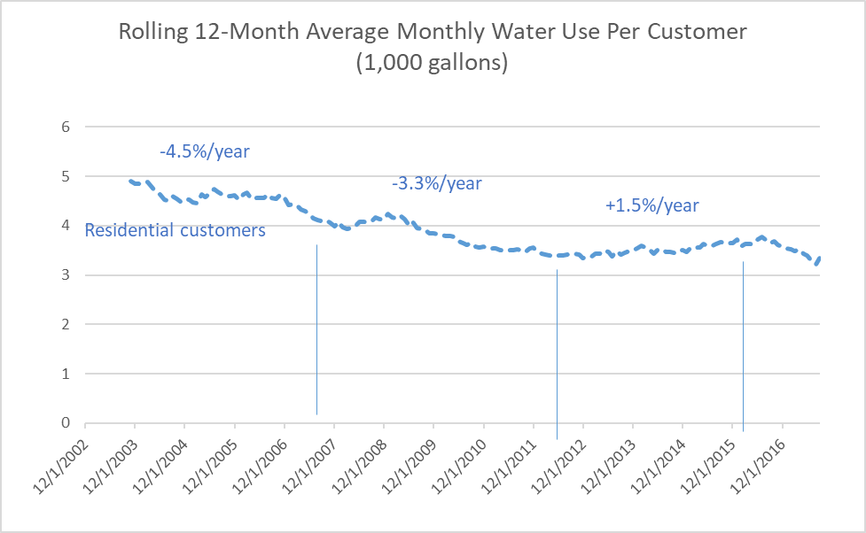
Fair Bluff Water Use Per Customer
Notes:
Cypress Apartments are NOT being charged volumetric rates. They only have flat monthly fees. So does this mean that the volumes recorded in billing are inaccurate (because they don’t matter)? Similar to County Board of Education – has fixed charge, not usage records.

Slide 26
Potential Causes

Slide 27
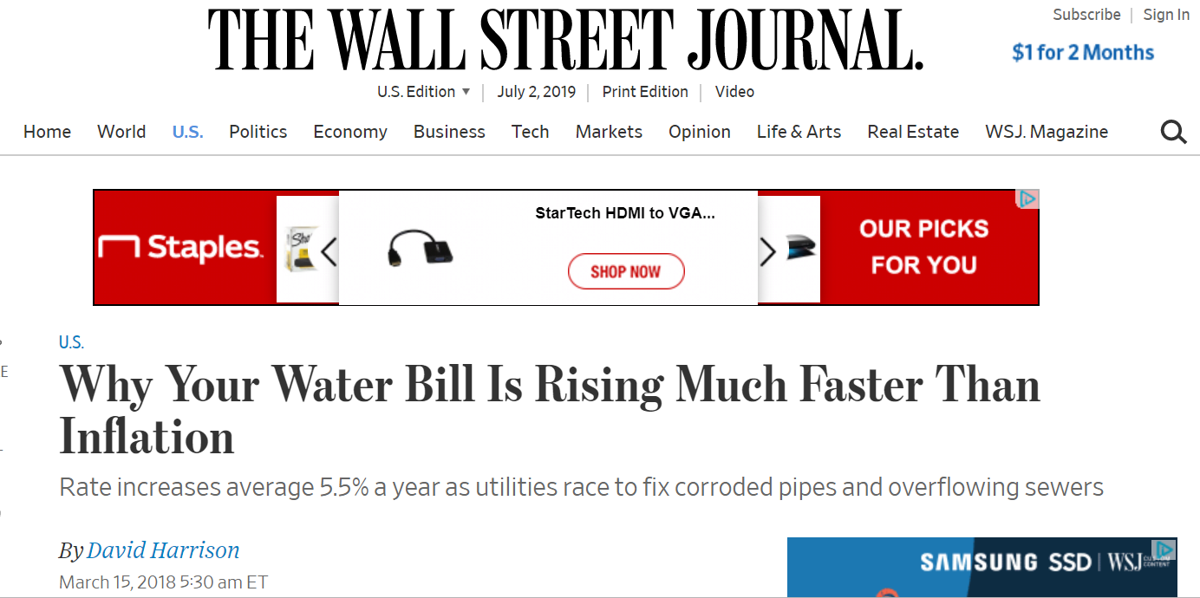
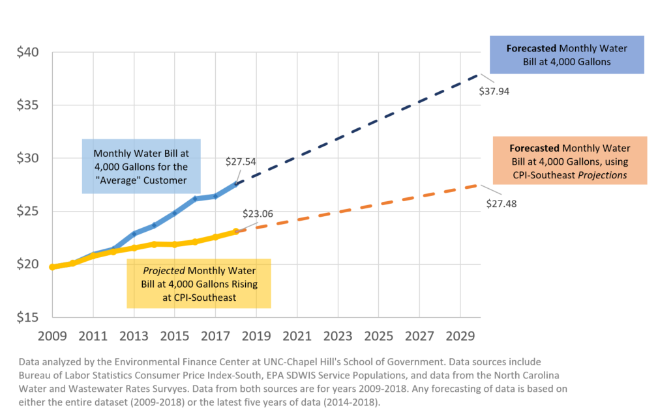
Rate Changes
Figure 1: Average Monthly Customer Water Bill: Forecasted based on Bill Trends vs. CPI at 4,000 Gallons, 2009-2030 (n=226 utilities)
Circle of Blue, The Price of Water, 2019
Notes:
Water rates are rising
Circle of blue
NC EFC blog
Even WSJ reporting on it
Price elasticity—we know there is a minimum that must be used, but customers will continue to be price sensitive until that point.
Do not anticipate rates going down any time soon

Slide 28
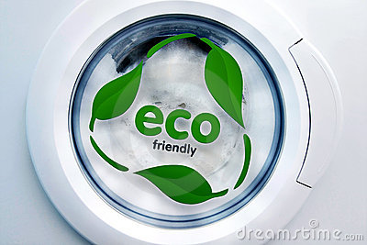
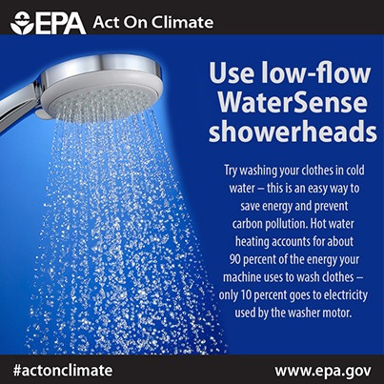
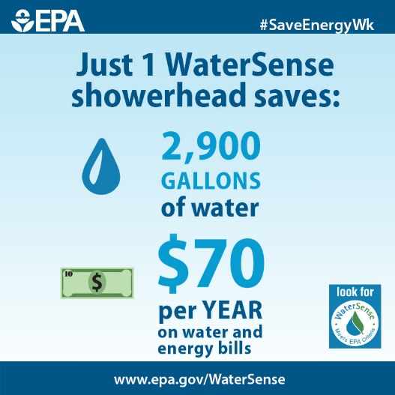
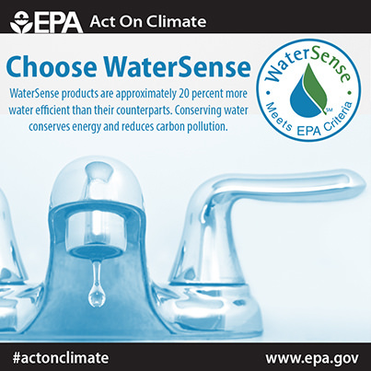
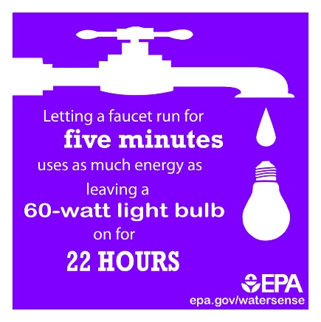
Increased Efficiency
Notes:
Do not anticipate appliances becoming less efficient—these are realized changes that we likely will not see demand rebound from

Slide 29
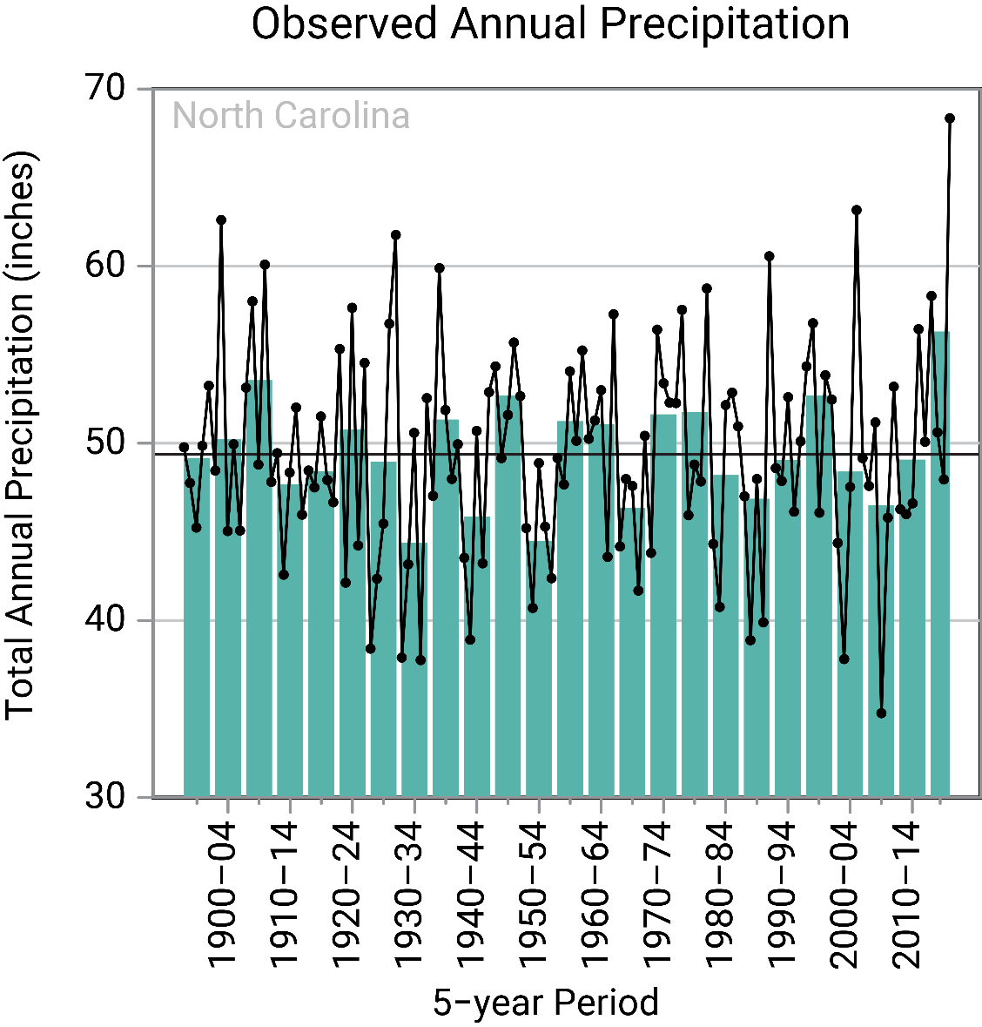
Weather
In the last five years, NC has experienced an uptick in the observed annual precipitation.
We know this isn’t uniformly distributed across the state, but it can have an impact on demand.
Source: CICS-NC and NOAA NCEI.
Notes:
This is variable! Could shift over time

Slide 30
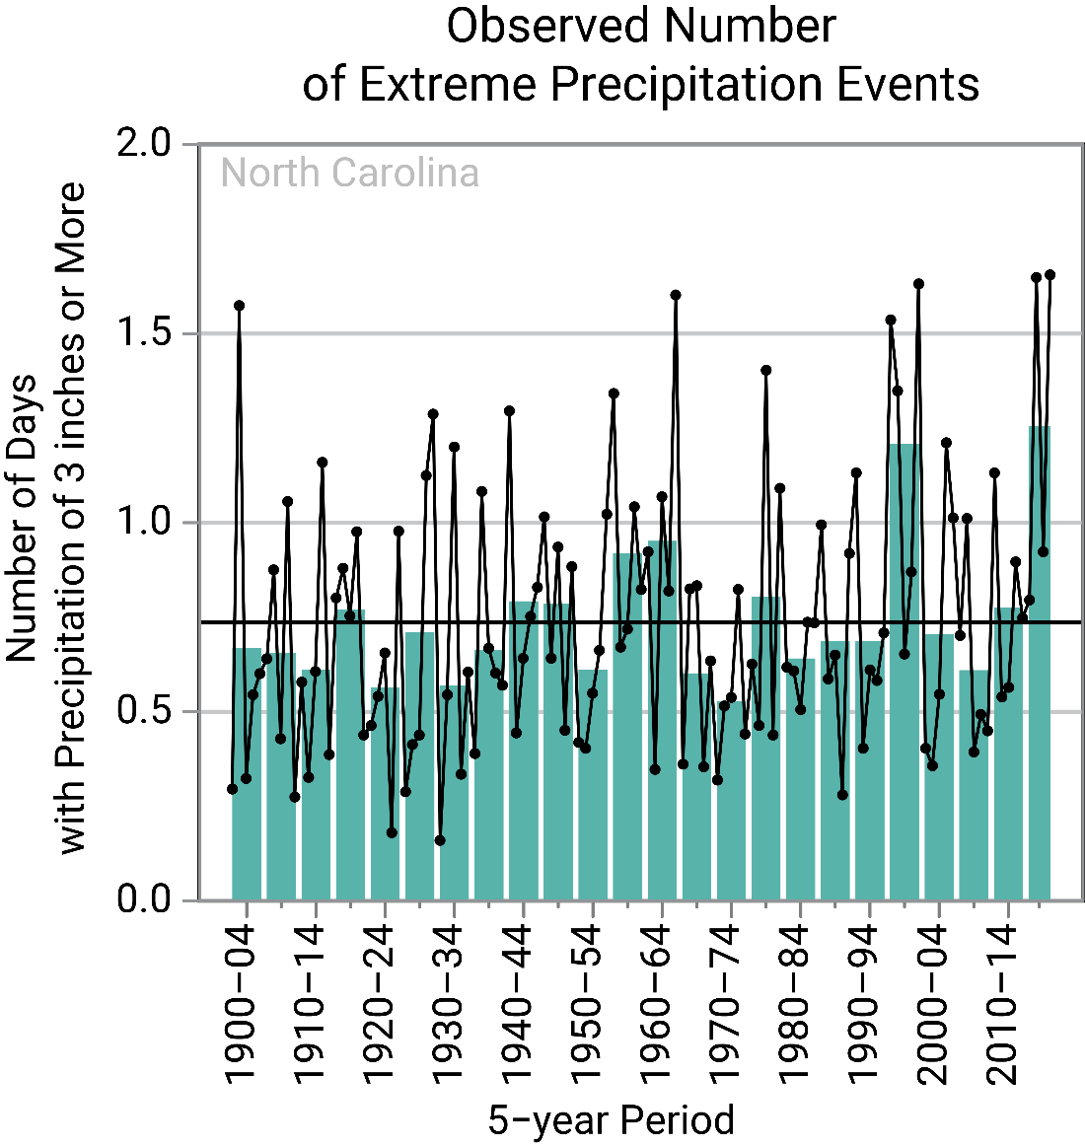
Weather
In addition to the unequal spatial distribution, the recent uptick in precipitation hasn’t been uniform across time.
Between 2015-2018, NC experienced more extreme precipitation events than any five year period since 1995-2000.
In short, we know weather impacts demand, but we can’t say by how much, or where…
Source: CICS-NC and NOAA NCEI.

Slide 31
Austin Thompson Thompson@sog.unc.edu 919.962.5795

Slide 32
Reminder! Takeaways
Water usage patterns differ in different regions
Overall water usage is falling across the state
Water usage per connection is falling across the state

